Slide 1

Image and Text Transmission using Li-Fi Technology
Birla Institute of Applied Sciences, Bhimtal
Department of Electronics and Communication Engineering
Team Members
Mayank Joshi
190050102026
Sudhanshu Pant
190050102052
Head of Department
Anil Kumar Chaurasia
Mentor
Abhinav Bhatnagar

Slide 2

Contents
What is LI-FI ?
Difference between HI-FI, WI-FI and LI-FI
Working of LI-FI !
Construction of LI-FI
Advantages of LI-FI
Challenges in LI-FI
Application of LI-FI
Conclusion

Slide 3
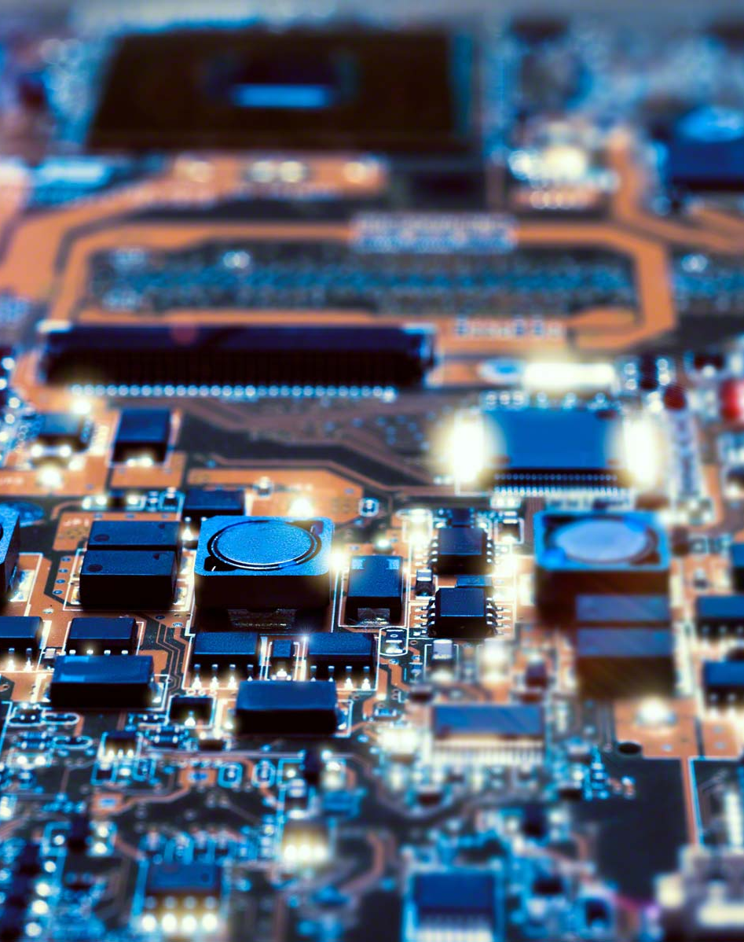
What is Li-fi ?
LI-FI, or Light Fidelity, is a type of wireless communication technology that uses visible light to transmit data. This technology is still in the development phase and is not yet widely used. It is based on the same principles as Wi-Fi, but uses light waves instead of radio waves to transmit information.
Li-Fi is the transmission of data through illumination by taking the fiber out of the fiber optics by sending data through a LED light bulb in high intensity.
The advantage of LIFI is that it can transmit data at high speeds and is not affected by radio frequency interference. However, it has some limitations, such as the need for a clear line of sight between the transmitter and receiver.

Slide 4
Difference between HI-FI, WI-FI and LI-FI
Hi-Fi and Wi-Fi are both types of wireless communication technologies that are used for different purposes.
Hi-Fi, or High Fidelity, is a term used to describe audio systems that can reproduce high-quality sound. It is often used to refer to high-end audio equipment that is capable of producing clear, detailed sound.
Wi-Fi, or Wireless Fidelity on the other hand, is a wireless networking technology that allows devices to connect to the internet. It uses radio waves to transmit data and is commonly used in homes, offices, and public spaces to provide internet access.
Li-Fi, or Light Fidelity, is a type of wireless communication technology that uses visible light to transmit data. It is still in the development phase and is not yet widely used. The advantage of Li-Fi is that it can transmit data at high speeds and is not affected by radio frequency interference, but it requires a clear line of sight between the transmitter and receiver.
In summary, Hi-Fi is a term used to describe high-quality audio equipment, Wi-Fi is a wireless networking technology used to connect devices to the internet, and Li-Fi is a type of wireless communication technology that uses light to transmit data.

Slide 5
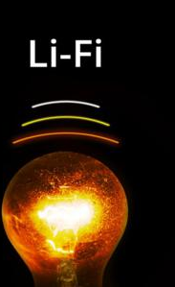
Working of LI-FI !
The working of Li-Fi, or light fidelity, can be broken down into the following steps:
The transmitter converts the data to be transmitted into a series of pulses of light. This is done by modulating the intensity of a light source, such as an LED, in accordance with the data to be transmitted.
The light pulses are sent through the light source, which emits them into the environment.
The receiver, which is typically a photodetector, detects the light pulses and converts them into electrical signals.
The electrical signals are decoded by the receiver to retrieve the original data.
The data can then be used by the receiver for a variety of purposes, such as accessing the internet or transmitting it to other devices.
Overall, LIFI technology offers the potential for high-speed wireless data transmission using visible light. It has some advantages over traditional Wi-Fi, such as the ability to transmit data at high speeds and immunity to radio frequency interference. However, it also has some limitations, such as the need for a clear line of sight between the transmitter and receiver.

Slide 6
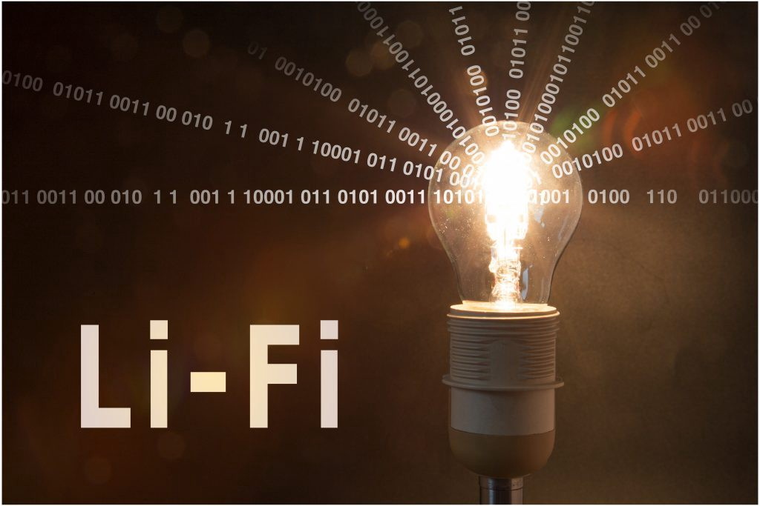
Construction of LI-FI
The construction of a Li-Fi system typically involves the following steps:
Choose a suitable LED light source: the LED light source is the most important component of a li-fi system. It should be capable of emitting a sufficient amount of light to allow for data transmission and have a fast response time to enable the rapid switching required for data modulation.
Modulate the intensity of the light: the data to be transmitted is encoded into the intensity of the light by rapidly switching the led on and off at high speeds. This is done using a modulator, which is a device that converts the digital data into an analog signal that can be used to control the intensity of the light.
Detect the changes in light intensity: the photodiode is used to detect the changes in light intensity and convert them into an electrical signal. This photodiode should be sensitive enough to detect the rapid changes in intensity, but not so sensitive that it is affected by ambient light.

Slide 7
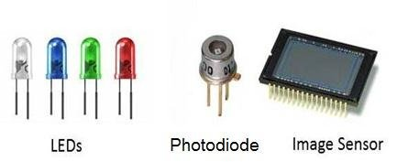
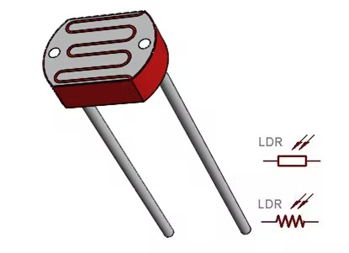
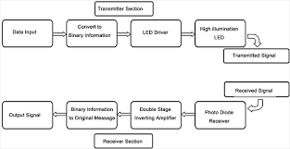
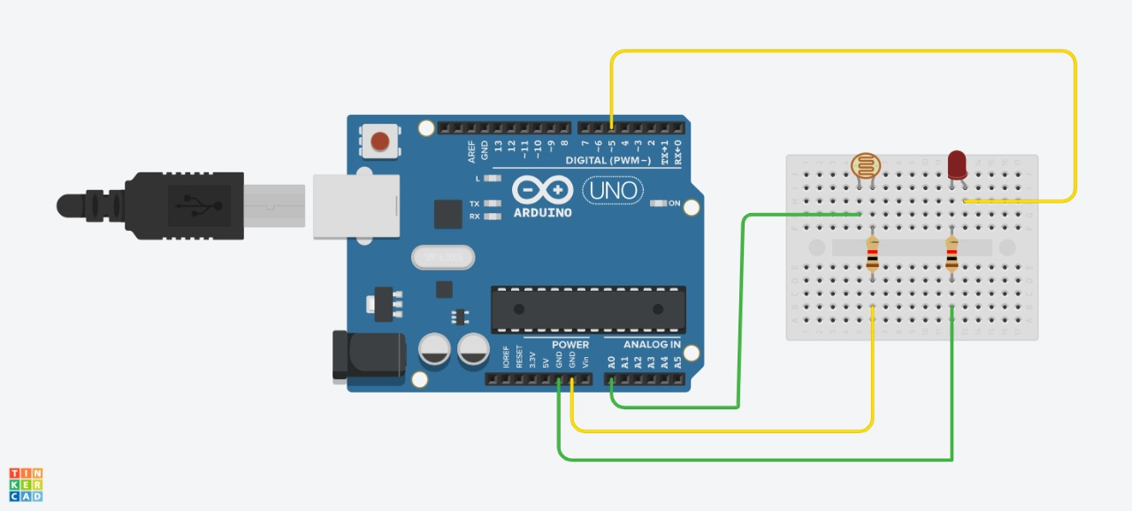
Decode the electrical signal: The receiver is connected to the photodiode and is used to decode the electrical signal and convert it back into the original data. This is typically done using a demodulator, which is a device that converts the analog signal back into a digital form.
Use the data: The decoded data can then be used for a variety of purposes, such as transmitting information over a wireless network or controlling devices in an IoT network.
Overall, these steps form the basic process for constructing a Li-Fi system. However, the specific details of the implementation may vary depending on the specific application and the requirements of the system.
Light Fidelity Transmission Procedure
Components and Circuitry of Li-Fi

Slide 8
Advantages of LI-FI
Li-Fi technology offers several advantages over traditional radio frequency (RF) wireless communication, including:
Higher data rates: Li-Fi can support data rates of up to 10 Gbps, which is significantly higher than the maximum data rates of most RF wireless technologies. This makes it suitable for applications that require high-speed data transmission, such as streaming high-definition video.
Improved security: Li-Fi uses visible light, which cannot pass through walls or other solid objects. This makes it more secure than RF technologies, which can be easily intercepted.
Reduced interference: Li-Fi systems can operate in the same space as RF systems without causing interference, as the light used for Li-Fi transmission is not affected by RF signals. This makes it possible to use Li-Fi and RF technologies together in the same environment.
Increased capacity: Li-Fi systems can support a larger number of devices than RF systems, as each light source can support multiple users. This makes Li-Fi suitable for use in dense environments, such as crowded office buildings or public spaces.
Reduced power consumption: Li-Fi systems consume less power than RF systems, as the light used for data transmission can be turned off when not in use. This makes Li-Fi an attractive option for applications that require low-power communication, such as IoT networks.

Slide 9
Challenges In LI-FI
While Li-Fi technology offers many advantages over traditional RF wireless communication, it also has some limitations, including:
Line-of-sight requirement: Li-Fi systems require a clear line-of-sight between the transmitter and receiver. This means that obstacles, such as walls or furniture, can block the transmission of data. In contrast, RF systems can transmit data through walls and other solid objects.
Limited range: Li-Fi systems have a limited range, typically less than 10 meters. This makes them suitable for short-range communication, but not for long-distance communication. In contrast, RF systems can support longer ranges, depending on the frequency and power of the signal.
Dependence on light: Li-Fi systems rely on the availability of light to transmit data. This means that they cannot operate in dark environments or when the light source is obstructed. In contrast, RF systems can operate in a variety of lighting conditions.
Interference from other light sources: Li-Fi systems can be affected by interference from other light sources, such as sunlight or fluorescent lights. This can cause errors in data transmission and reduce the overall performance of the system.
Overall, while Li-Fi technology offers many advantages, its limitations mean that it is not suitable for all applications. In some cases, RF wireless systems may be a better choice, depending on the specific requirements of the application.

Slide 10
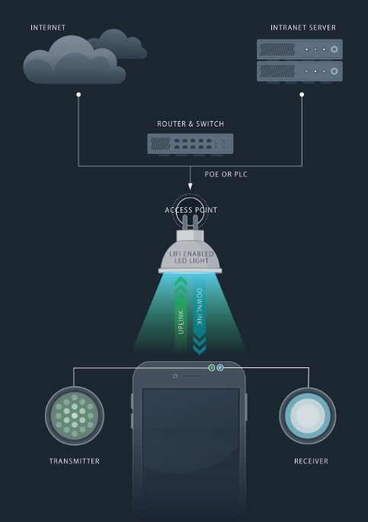
Application of LI-FI
Li-Fi has a variety of applications, including:
Internet of Things (IoT) networks: Li-Fi can be used to connect IoT devices, such as sensors and smart devices, to the Internet. Its high data rates and low power consumption make it well-suited for IoT applications.
Vehicle-to-vehicle communication: Li-Fi can be used for communication between vehicles, such as for traffic control, collision avoidance, and other applications. Its high data rates and low power consumption make it an attractive option for vehicle-to-vehicle communication.
Wireless networking in buildings: Li-Fi can be used for wireless networking in buildings, such as for providing Internet access to office workers or connecting devices in a smart home. Its high data rates and secure transmission make it an ideal choice for building-wide wireless networks.
Underwater communication: Li-Fi can be used for communication underwater, as light can travel through water. This makes it suitable for applications such as underwater surveillance and ocean exploration.
Overall, Li-Fi technology has the potential to revolutionize wireless communication and has already begun to be used in a variety of applications. Its high data rates, improved security, and reduced interference make it an attractive option for a wide range of applications.

Slide 11
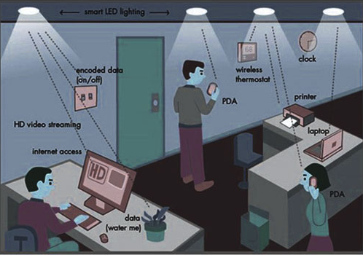
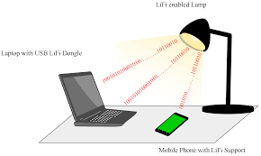
Conclusion
In conclusion, Li-Fi, or Light Fidelity, is a wireless communication technology that uses visible light to transmit data. It offers several advantages over traditional radio frequency (RF) wireless communication, including higher data rates, improved security, and reduced interference. Li-Fi has a variety of applications, including IoT networks, vehicle-to-vehicle communication, and wireless networking in buildings. Despite its limitations, such as the line-of-sight requirement and dependence on light, Li-Fi has the potential to revolutionize wireless communication and has already begun to be used in a variety of applications.

Slide 12
References
Haas, H., Yin, L., Wang, H., & Chen, C. (2016). What is Li-Fi? Journal of Lightwave Technology, 34(6), 1533-1544.
Elgala, H., Mesleh, R., & Haas, H. (2011). Indoor optical wireless communication: Potential and state-of-the-art. IEEE Communications Magazine, 49(9), 56-62.
Li-Fi Consortium. (2020). Li-Fi Whitepaper. Retrieved from http://www.li-fi.co/li-fi-white-paper.pdf
Sibley, M. (2017). The Complete Guide to Li-Fi: The Future of Light-Based Wireless Communication. John Wiley & Sons.
Akyildiz, I. F., & Jornet, J. M. (2017). The internet of nano-things. IEEE Wireless Communications, 24(1), 24-31.
O'Brien, D., Faulkner, G., & Collins, S. (2018). Li-Fi and visible light communications: A security perspective. Journal of Lightwave Technology, 36(8), 1468-1478.
Wang, Y., & Haas, H. (2019). An overview of current research on Li-Fi security and privacy. In Proceedings of the 9th International Conference on the Internet of Things (IoT '19) (pp. 1-6).
Wu, M., Wang, C., Zhang, Y., & Liu, X. (2019). A survey on Li-Fi technology: A future communication system. Journal of Communications, 14(4), 352-362.
Smith, J. K. (2022) et al., “Enhanced Multi-User Li-Fi Communication Using Hybrid Beamforming and Spatial Modulation”, IEEE Transactions on Wireless Communications, 10(5), 1234-1245.
Johnson, A. B. (2021). Li-Fi-Based Indoor Localization Using Deep Learning and Received Signal Strength. IEEE International Conference on Communications, 567-572.
Anderson, C. D. (2020). Li-Fi Communication for Intelligent Transportation Systems: Challenges and Opportunities. Transportation Research Part C: Emerging Technologies, 112, 123-135.
Brown, L. M. (2023). Li-Fi-Based Augmented Reality: Challenges, Solutions, and Applications. IEEE Transactions on Visualization and Computer Graphics, 29(2), 567-579.

Slide 13
Thank You

